Slide 1
Lecture 3: Deeper into Deep Learning and Optimizations
Deep Learning @ UvA

Slide 2
Previous lecture
Machine Learning Paradigm for Neural Networks
The Backpropagation algorithm for learning with a neural network
Neural Networks as modular architectures
Various Neural Network modules
How to implement and check your very own module

Slide 3
Lecture overview
How to defining our model and optimize it in practice
Data preprocessing and normalization
Optimization methods
Regularizations
Architectures and architectural hyper-parameters
Learning rate
Weight initializations
Good practices

Slide 4
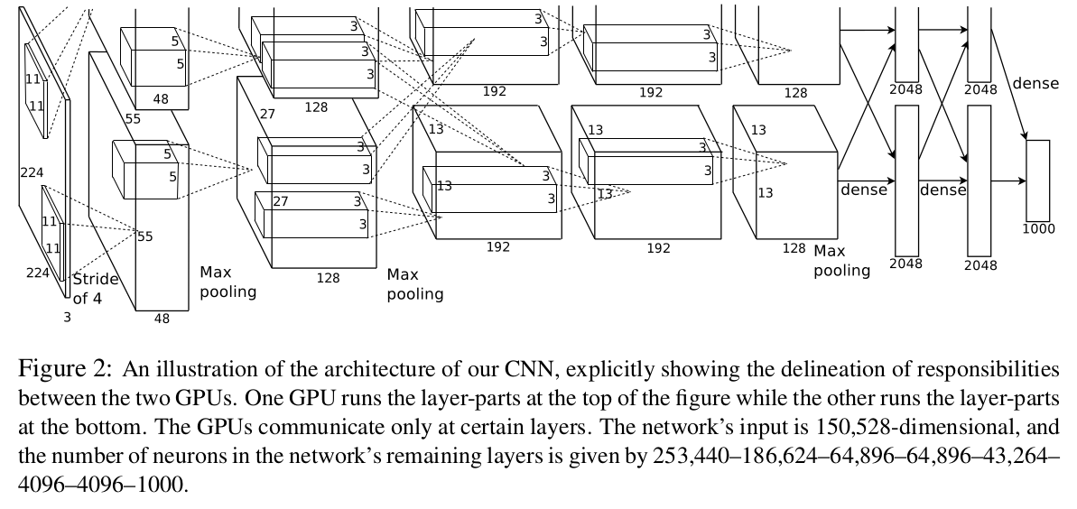
Deeper into Neural Networks & Deep Neural Nets

Slide 5
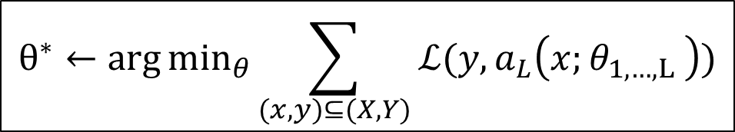
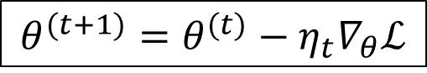
A Neural/Deep Network in a nutshell
1. The Neural Network
$$a_{L}\left(x;θ_{1,…,L} \right)=h_{L} (h_{L−1}\left(…h_{1}\left(x,θ_{1}\right),θ_{L−1}\right), θ_{L})$$
2. Learning by minimizing empirical error
$$θ^{∗}←\arg{\min_{θ}{\sum_{(x,y)⊆(X, Y)}{ℒ(y,a_{L}\left(x;θ_{1,…,L} \right))}}}$$
3. Optimizing with Gradient Descend based methods
$$θ^{(t+1)}=θ^{(t)}−η_{t}∇_{θ}ℒ$$

Slide 6
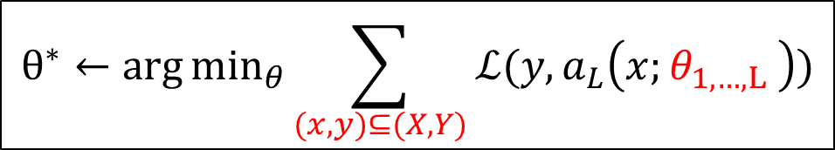
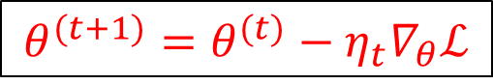
SGD vs GD
1. The Neural Network
$$a_{L}\left(x;θ_{1,…,L} \right)=h_{L} (h_{L−1}\left(…h_{1}\left(x,θ_{1}\right),θ_{L−1}\right), θ_{L})$$
2. Learning by minimizing empirical error
$$θ^{∗}←\arg{\min_{θ}{\sum_{(x,y)⊆(X, Y)}{ℒ(y,a_{L}\left(x;θ_{1,…,L} \right))}}}$$
3. Optimizing with Gradient Descend based methods
$$θ^{(t+1)}=θ^{(t)}−η_{t}∇_{θ}ℒ$$

Slide 7
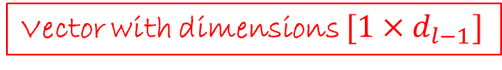
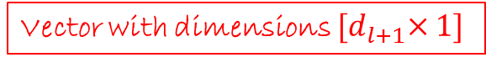
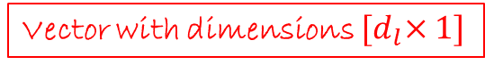
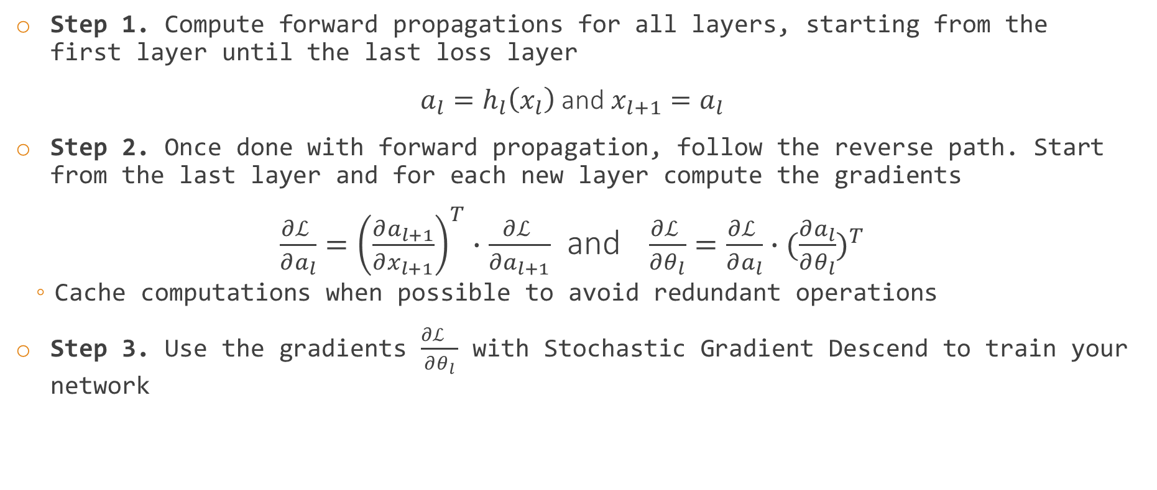
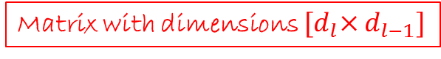
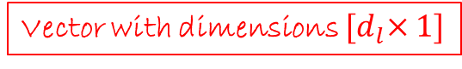
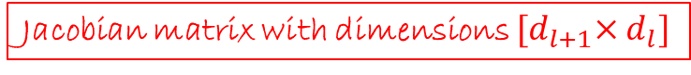
Backpropagation again
Step 1. Compute forward propagations for all layers, starting from the first layer until the last loss layer
$a_{l}=h_{l}\left(x_{l}\right)$ and $x_{l+1}=a_{l}$
Step 2. Once done with forward propagation, follow the reverse path. Start from the last layer and for each new layer compute the gradients
$\frac{∂ℒ }{∂a_{l}}={\left(\frac{∂a_{l+1}}{∂x_{l+1}}\right)}^{T}∙\frac{∂ℒ }{∂a_{l+1}}$ and $\frac{∂ℒ }{∂θ_{l}}=\frac{∂ℒ }{∂a_{l}}∙{(\frac{∂a_{l}}{∂θ_{l}})}^{T}$
Cache computations when possible to avoid redundant operations
Step 3. Use the gradients $\frac{∂ℒ }{∂θ_{l}}$ with Stochastic Gradient Descend to train your network
Vector with dimensions $[1×d_{l−1}]$
Vector with dimensions ${[d}_{l}×1]$
Vector with dimensions ${[d}_{l}×1]$
Vector with dimensions ${[d}_{l+1}×1]$
Jacobian matrix with dimensions ${[d}_{l+1}×d_{l}]$
Matrix with dimensions ${[d}_{l}×d_{l−1}]$

Slide 8
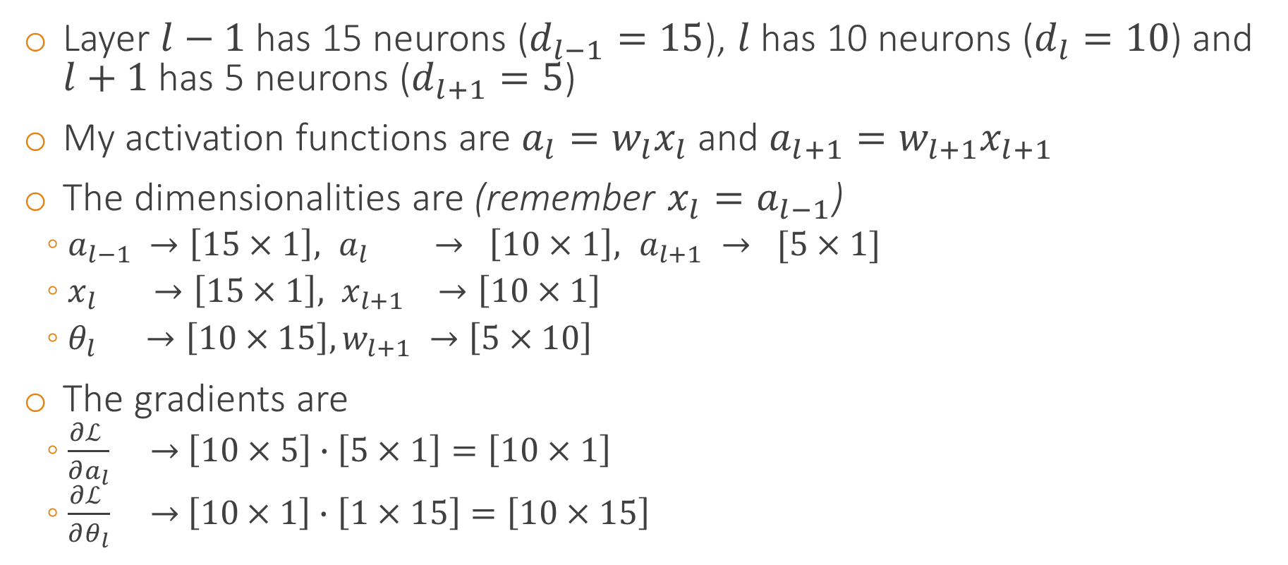
Practical example and dimensionality analysis
Layer $l−1$ has 15 neurons ($d_{l−1}=15$), $l$ has 10 neurons ($d_{l}=10$) and $l+1$ has 5 neurons ($d_{l+1}=5$)
My activation functions are $a_{l}=w_{l}x_{l}$ and $a_{l+1}=w_{l+1}x_{l+1}$
The dimensionalities are (remember $x_{l}=a_{l−1}$)
$a_{l−1} →\left[15×1\right],{ a}_{l} → \left[10×1\right],{ a}_{l+1} → [5×1]$
$x_{l} →\left[15×1\right], x_{l+1} →\left[10×1\right]$
$θ_{l} →\left[10×15\right], w_{l+1} →\left[5×10\right]$
The gradients are
$\frac{∂ℒ }{∂a_{l}} →$ $\left[10×5\right]∙\left[5×1\right]=\left[10×1\right]$
$\frac{∂ℒ }{∂θ_{l}} →$ $\left[10×1\right]∙\left[1×15\right]=\left[10×15\right]$

Slide 9
Why is backpropagation efficient?

Slide 10
Still, backpropagation can be slow
Often loss surfaces are
non-quadratic
highly non-convex
very high-dimensional
No real guarantee that
the final solution will be good
we converge fast to final solution
or that there will be convergence
How can we protect ourselves better?

Slide 11
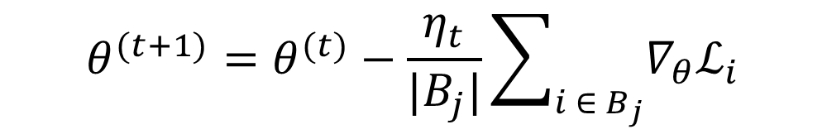
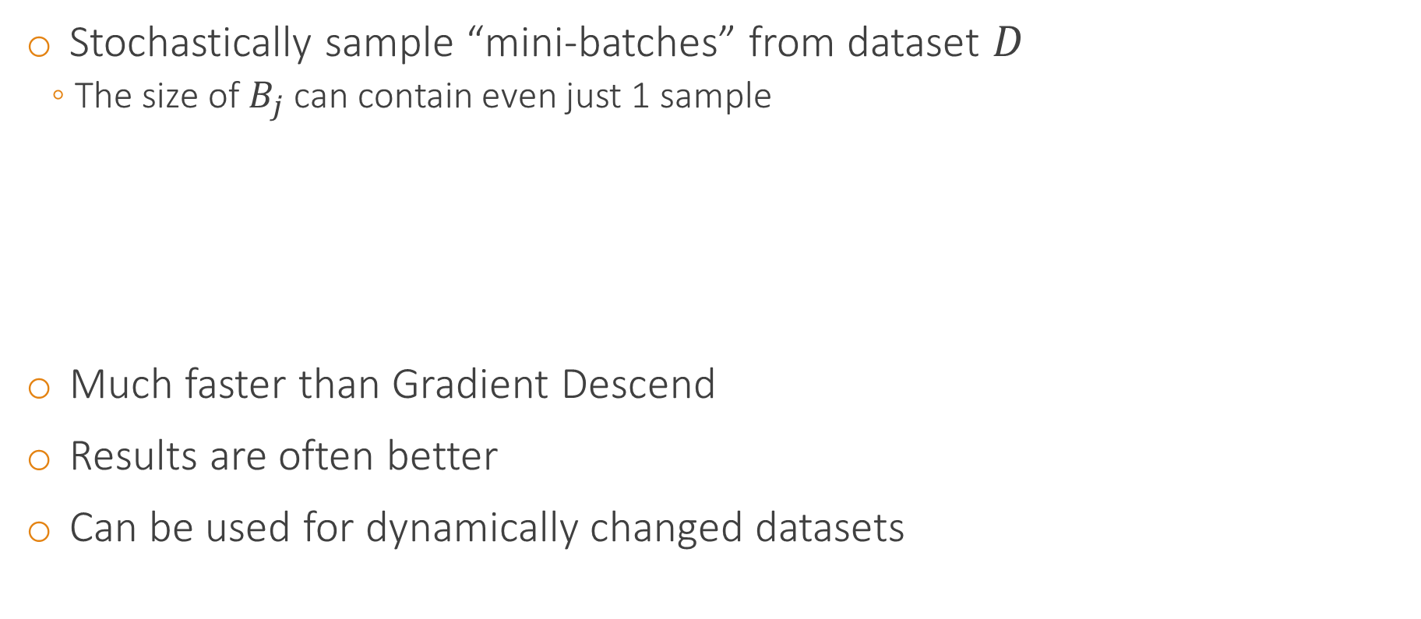
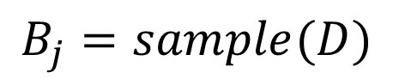
Stochastic Gradient Descend (SGD)
Stochastically sample “mini-batches” from dataset $D$
The size of $B_{j}$ can contain even just 1 sample
Much faster than Gradient Descend
Results are often better
Can be used for dynamically changed datasets
$$B_{j}=sample(D)$$
$$θ^{(t+1)}=θ^{(t)}−\frac{η_{t}}{|B_{j}|}\sum_{i ∈ B_{j}}{∇_{θ}ℒ_{i}}$$

Slide 12
SGD is often better
Loss surface
Current solution
Full GD gradient
Noisy SGD gradient
No guarantee that this is what is going to always happen.
But the noisy SGC gradients can help some times escaping local optima
New GD solution
Best GD solution
Best SGD solution

Slide 13
SGD is often better
The gradient is more “noisy”
A noisy gradient acts as regularization
Model does not assume that the training samples are the “absolute representative” of the input distribution
Traditional optimization problems: “find optimal route”
Instead, the model assumes that the sampled training data is roughly representative
So, model does not overfit to the particular training samples

Slide 14
SGD is faster
10x
Gradient
Gradient
What is our gradient now?

Slide 15
SGD is faster
Of course in real situations data do not replicate
However, after a sizeable amount of data there are clusters of data that are similar
Hence, the gradient is approximately alright
Approximate alright is great, is even better in many cases actually

Slide 16



SGD for dynamically changed datasets
Often datasets are not “rigid”
Imagine Instagram
Let’s assume 1 million of new images uploaded per week and we want to build a “cool picture” classifier
Should “cool pictures” from the previous year have the same as much influence?
No, the learning machine should track these changes
With GD these changes go undetected, as results are averaged by the many more “past” samples
Past “over-dominates”
A properly implemented SGD can track changes much better and give better models
[LeCun2002]
Cool this week
Cool in 2014
Cool in 2010

Slide 17
Shuffling examples
Dataset
Applicable only with SGD
Choose samples with maximum information content
Shuffle samples so that in a mini-batches the training examples are from different classes
As different as possible
Prefer samples that are more likely to generate larger errors
Otherwise gradients will be small and learning will be slow
Check the errors from previous rounds and prefer “hard examples”
Don’t overdo it though :P, beware of outliers
In practice, split your dataset into mini-batches
Each mini-batch is as class-divergent and rich as possible
At each new epoch create new batches with new, randomly shuffled examples
Shuffling at epoch t
Shuffling at epoch t+1

Slide 18
Advantages of Gradient Descend batch learning
Conditions of convergence well understood
The “good noise” prevents from finding the absolutely best (for our given training dataset) solution
Acceleration techniques can be applied
Second order (Hessian based) optimizations are possible
Measuring not only gradients, but also curvatures of the loss surface
Simpler theoretical analysis on weight dynamics and convergence rates

Slide 19
In practice
SGD is preferred to Gradient Descend
Training is orders faster
In real datasets Gradient Descend is not even realistic
Solutions are better and with better generalization
Important not only for efficiency, but also for dataset size scale-up
Much larger datasets, much better generalization
How many samples per mini-batch?
Hyper-parameter, trial & error
Usually between 32-256 samples for image datasets

Slide 20
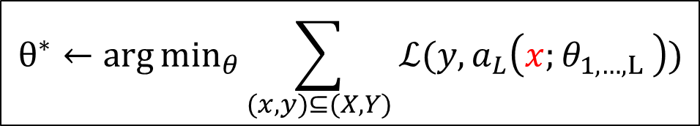
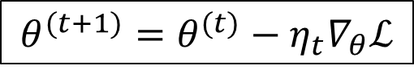
Data preprocessing & normalization
1. The Neural Network
$$a_{L}\left(x;θ_{1,…,L} \right)=h_{L} (h_{L−1}\left(…h_{1}\left(x,θ_{1}\right),θ_{L−1}\right), θ_{L})$$
2. Learning by minimizing empirical error
$$θ^{∗}←\arg{\min_{θ}{\sum_{(x,y)⊆(X, Y)}{ℒ(y,a_{L}\left(x;θ_{1,…,L} \right))}}}$$
3. Optimizing with Gradient Descend based methods
$$θ^{(t+1)}=θ^{(t)}−η_{t}∇_{θ}ℒ$$

Slide 21
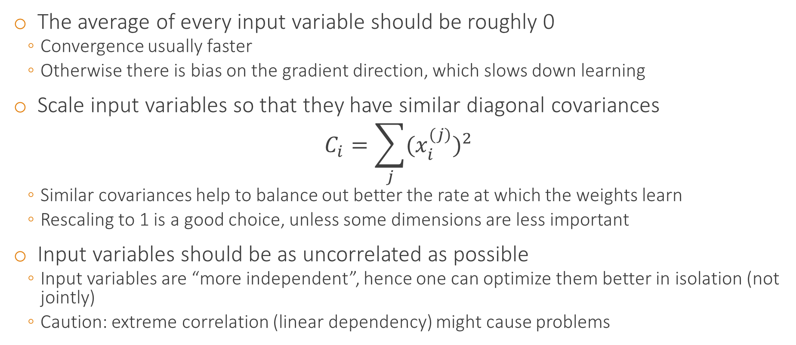
Data pre-processing
The average of every input variable should be roughly 0
Convergence usually faster
Otherwise there is bias on the gradient direction, which slows down learning
Scale input variables so that they have similar diagonal covariances
$$C_{i}=\sum_{j}{{(x_{i}^{(j)})}^{2}}$$
Similar covariances help to balance out better the rate at which the weights learn
Rescaling to 1 is a good choice, unless some dimensions are less important
Input variables should be as uncorrelated as possible
Input variables are “more independent”, hence one can optimize them better in isolation (not jointly)
Caution: extreme correlation (linear dependency) might cause problems

Slide 22
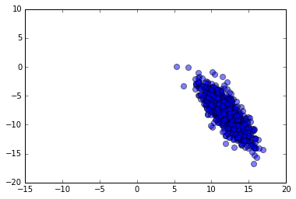
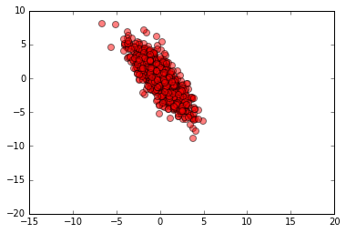
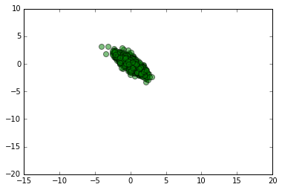
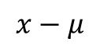
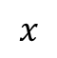
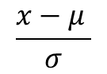
Normalization: $N\left(μ, σ^{2}\right)=N\left(0, 1\right)$
Input variables follow a Gaussian distribution (roughly)
In practice:
from training set compute mean and standard deviation
Then subtract the mean from training samples
Then divide the result by the standard deviation
$$x$$
$$x−μ$$
$$\frac{x−μ }{σ}$$

Slide 23
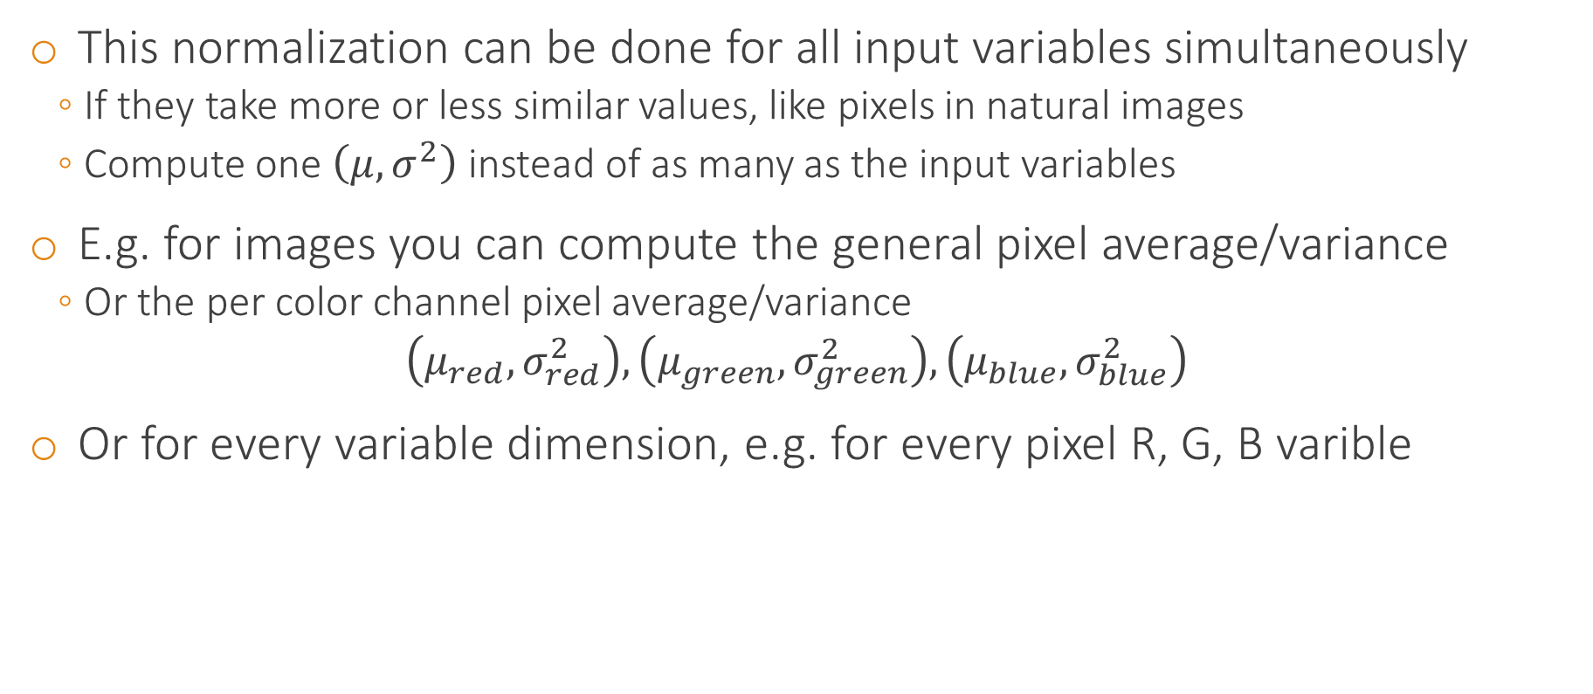
Normalization: $N\left(μ, σ^{2}\right)=N\left(0, 1\right)$
This normalization can be done for all input variables simultaneously
If they take more or less similar values, like pixels in natural images
Compute one $\left(μ, σ^{2}\right)$ instead of as many as the input variables
E.g. for images you can compute the general pixel average/variance
Or the per color channel pixel average/variance
$$\left(μ_{red},σ_{red}^{2}\right),\left(μ_{green},σ_{green}^{2}\right),\left(μ_{blue},σ_{blue}^{2}\right)$$
Or for every variable dimension, e.g. for every pixel R, G, B varible

Slide 24
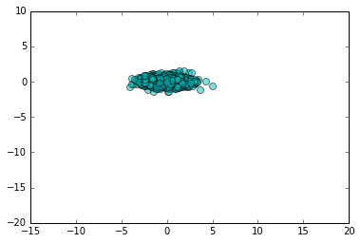
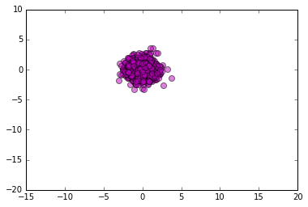
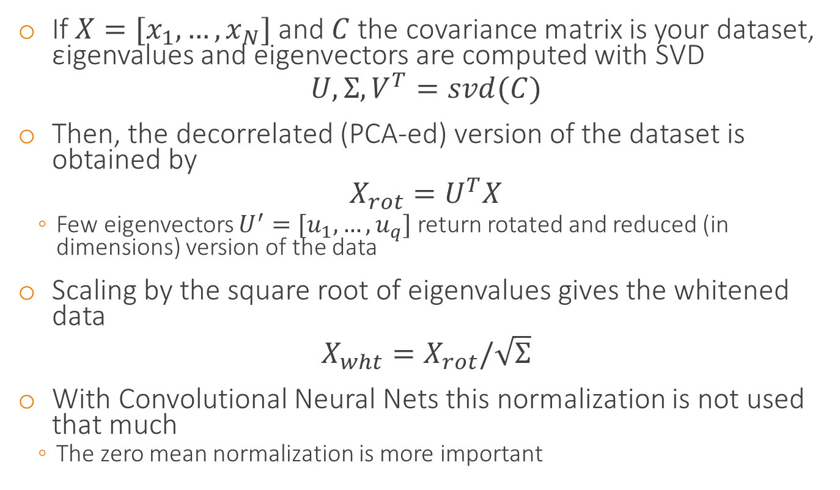
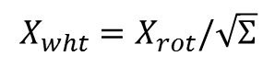
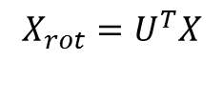
PCA Whitening
If $X=[x_{1}, …, x_{N}]$ and $C$ the covariance matrix is your dataset, εigenvalues and eigenvectors are computed with SVD
$$U, Σ,V^{T}=svd(C)$$
Then, the decorrelated (PCA-ed) version of the dataset is obtained by
$$X_{rot}=U^{T}X$$
Few eigenvectors $U^{′}=[u_{1}, …, u_{q}]$ return rotated and reduced (in dimensions) version of the data
Scaling by the square root of eigenvalues gives the whitened data
$$X_{wht}=X_{rot}/\sqrt{Σ}$$
With Convolutional Neural Nets this normalization is not used that much
The zero mean normalization is more important
$$X_{rot}=U^{T}X$$
$$X_{wht}=X_{rot}/\sqrt{Σ}$$

Slide 25
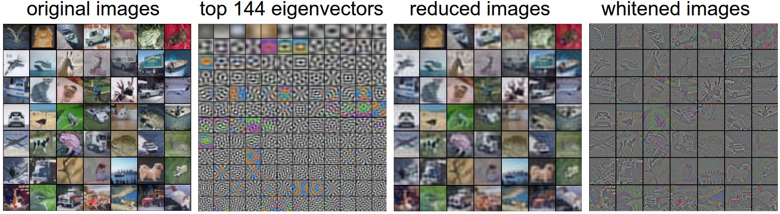
Example
Images taken from A. Karpathy course website: http://cs231n.github.io/neural-networks-2/

Slide 26
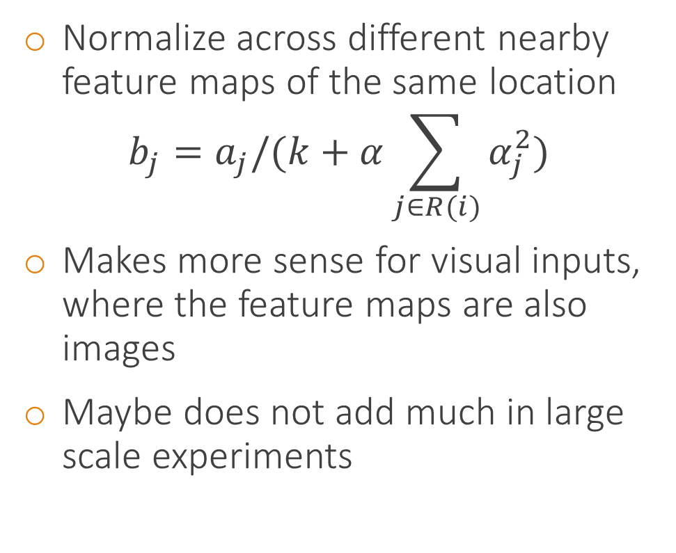
Local response normalization
Normalize across different nearby feature maps of the same location
$$b_{j}=a_{j}/(k+α\sum_{j∈R(i)}{α_{j}^{2}})$$
Makes more sense for visual inputs, where the feature maps are also images
Maybe does not add much in large scale experiments
Feature map l

Slide 27
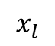
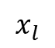
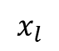
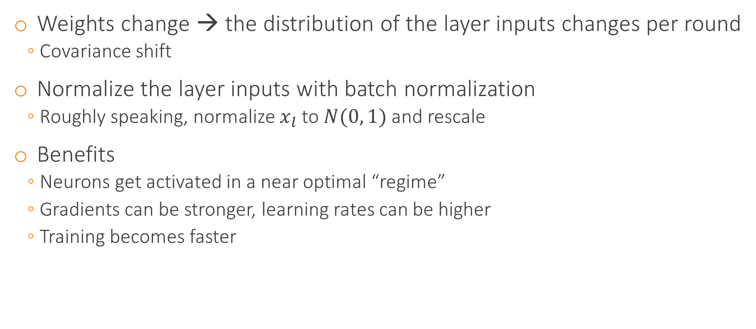
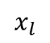
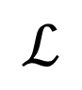
Batch normalization
Weights change → the distribution of the layer inputs changes per round
Covariance shift
Normalize the layer inputs with batch normalization
Roughly speaking, normalize $x_{l}$ to $N(0, 1)$ and rescale
Benefits
Neurons get activated in a near optimal “regime”
Gradients can be stronger, learning rates can be higher
Training becomes faster
$$ℒ$$
$$x_{l}$$
Backpropagation
Batch Normalization
$$x_{l}$$
$$x_{l}$$
$$x_{l}$$
Layer l input distribution at (t)
Layer l input distribution at (t+0.5)
Layer l input distribution at (t+1)

Slide 28
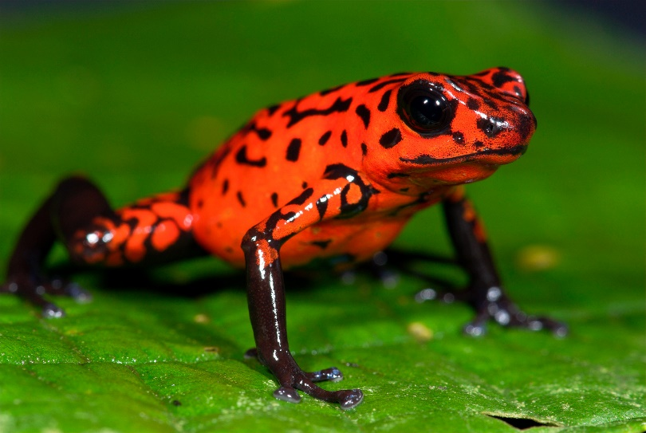
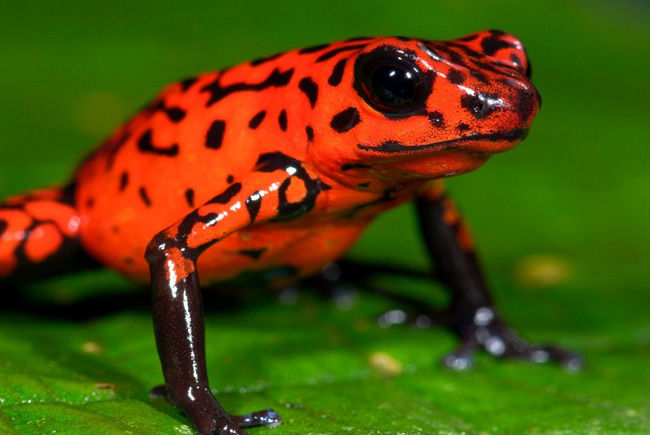

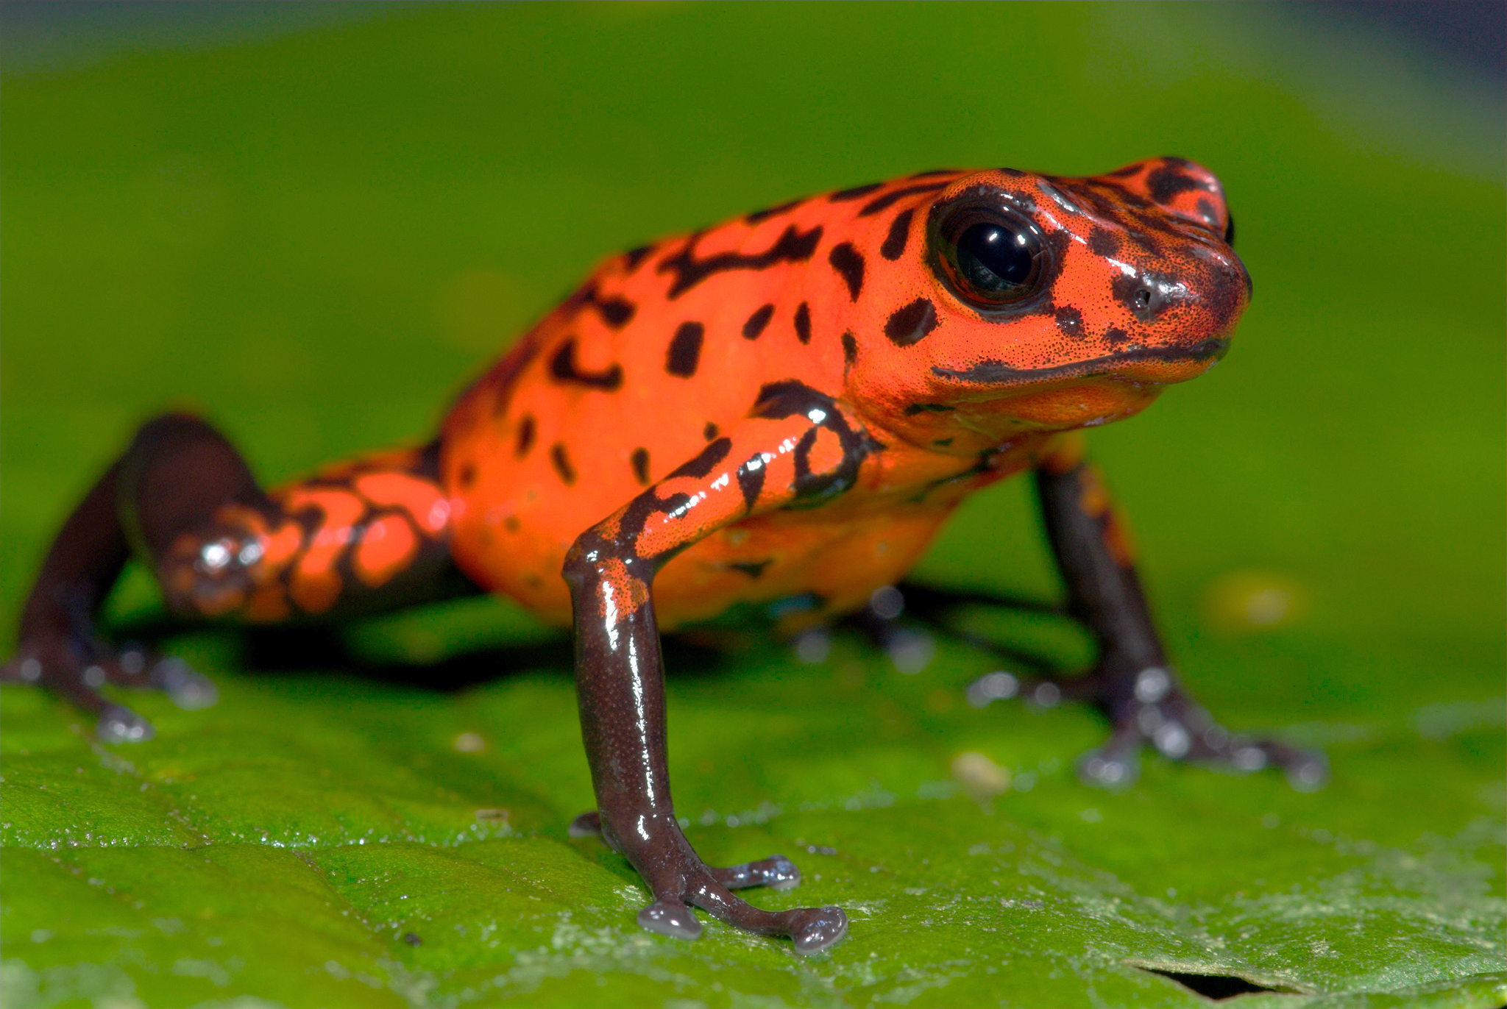
Data augmentation
Flip
Random crop
Original
Contrast
Tint

Slide 29
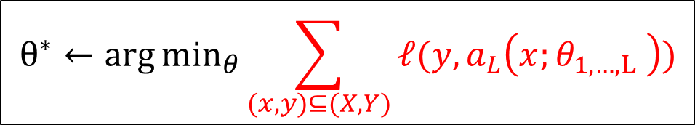
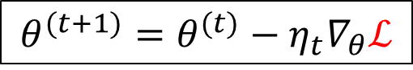
Regularization
1. The Neural Network
$$a_{L}\left(x;θ_{1,…,L} \right)=h_{L} (h_{L−1}\left(…h_{1}\left(x,θ_{1}\right),θ_{L−1}\right), θ_{L})$$
2. Learning by minimizing empirical error
$$θ^{∗}←\arg{\min_{θ}{\sum_{(x,y)⊆(X, Y)}{ℓ(y,a_{L}\left(x;θ_{1,…,L} \right))}}}$$
3. Optimizing with Gradient Descend based methods
$$θ^{(t+1)}=θ^{(t)}−η_{t}∇_{θ}ℒ$$

Slide 30
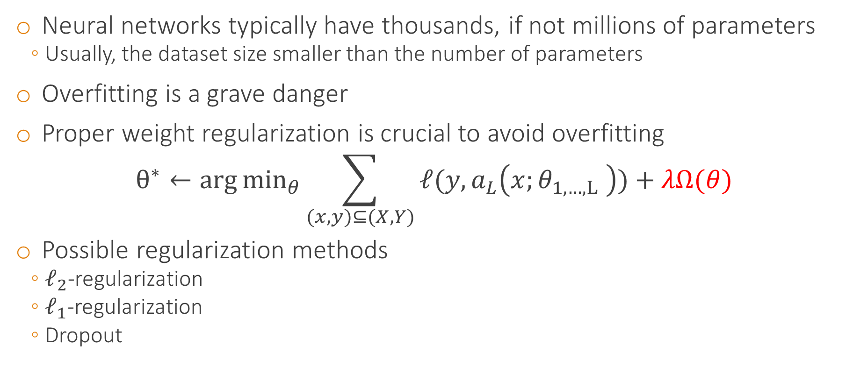
Regularization
Neural networks typically have thousands, if not millions of parameters
Usually, the dataset size smaller than the number of parameters
Overfitting is a grave danger
Proper weight regularization is crucial to avoid overfitting
$$θ^{∗}←\arg{\min_{θ}{\sum_{(x,y)⊆(X, Y)}{ℓ(y,a_{L}\left(x;θ_{1,…,L} \right))}}}+λΩ(θ)$$
Possible regularization methods
$ℓ_{2}$-regularization
$ℓ_{1}$-regularization
Dropout

Slide 31
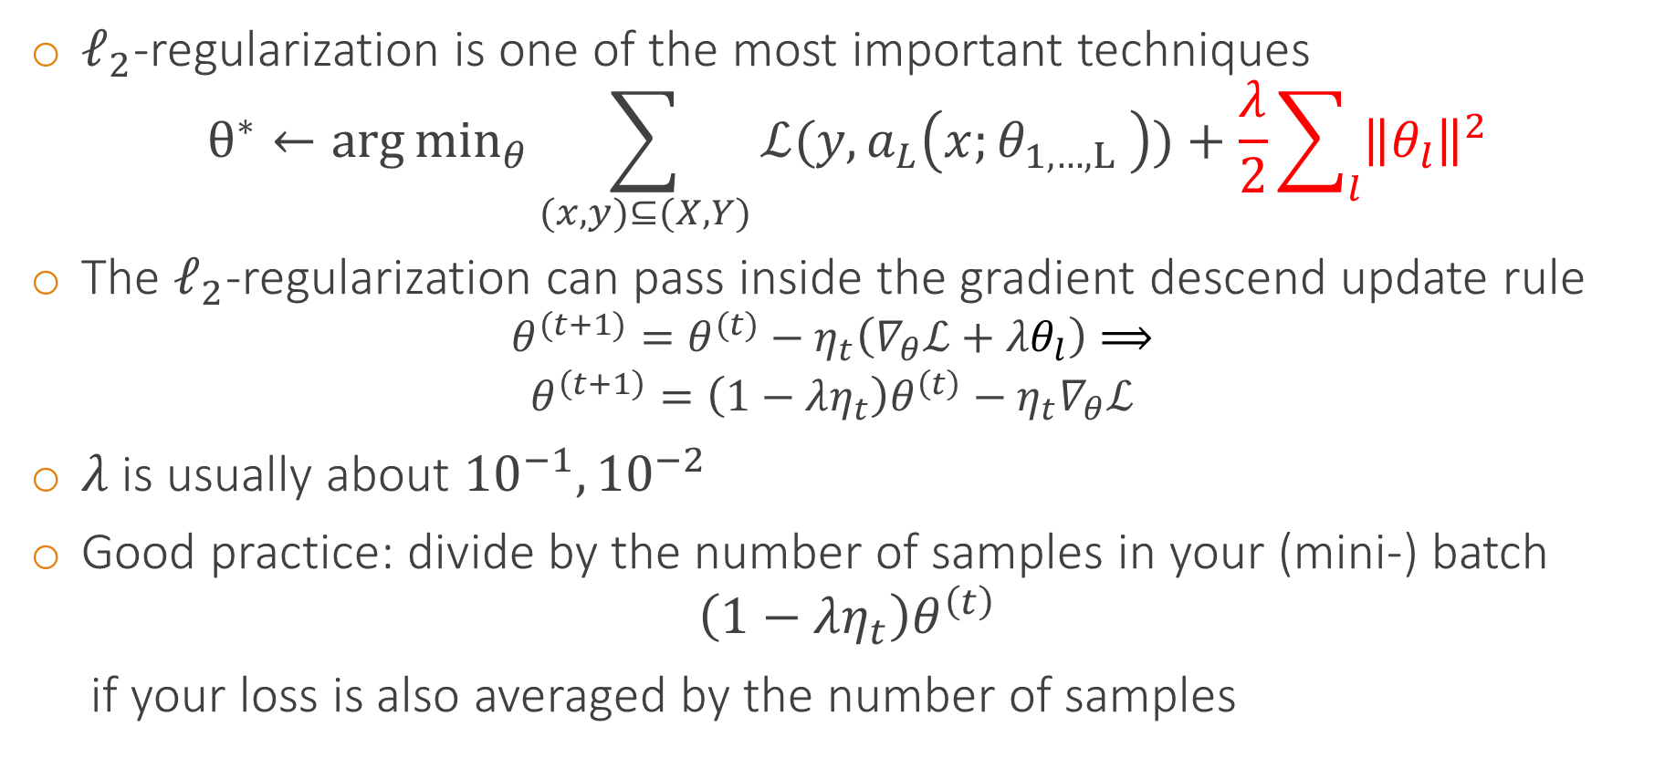
$ℓ_{2}$-regularization
$ℓ_{2}$-regularization is one of the most important techniques
$$θ^{∗}←\arg{\min_{θ}{\sum_{(x,y)⊆(X, Y)}{ℒ(y,a_{L}\left(x;θ_{1,…,L} \right))}}}+\frac{λ}{2}\sum_{l}{{\left\|θ_{l}\right\|}^{2}}$$
The $ℓ_{2}$-regularization can pass inside the gradient descend update rule
$$θ^{(t+1)}=θ^{(t)}−η_{t}\left(∇_{θ}ℒ+λθ_{l}\right)⟹$$
$$θ^{\left(t+1\right)}=\left(1−λη_{t}\right)θ^{\left(t\right)}−η_{t}∇_{θ}ℒ$$
$λ$ is usually about ${10}^{−1},{10}^{−2}$
Good practice: divide by the number of samples in your (mini-) batch
$$\left(1−λη_{t}\right)θ^{\left(t\right)}$$
if your loss is also averaged by the number of samples
“Weight decay”, because weights get smaller

Slide 32
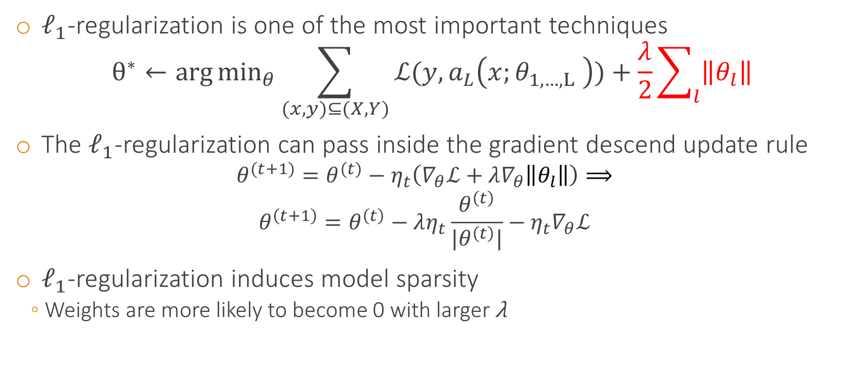
$ℓ_{1}$-regularization
$ℓ_{1}$-regularization is one of the most important techniques
$$θ^{∗}←\arg{\min_{θ}{\sum_{(x,y)⊆(X, Y)}{ℒ(y,a_{L}\left(x;θ_{1,…,L} \right))}}}+\frac{λ}{2}\sum_{l}{\left\|θ_{l}\right\|}$$
The $ℓ_{1}$-regularization can pass inside the gradient descend update rule
$$θ^{(t+1)}=θ^{(t)}−η_{t}\left(∇_{θ}ℒ+λ∇_{θ}\left\|θ_{l}\right\|\right)⟹$$
$$θ^{\left(t+1\right)}=θ^{\left(t\right)}−λη_{t}\frac{θ^{\left(t\right)}}{|θ^{\left(t\right)}|}−η_{t}∇_{θ}ℒ$$
$ℓ_{1}$-regularization induces model sparsity
Weights are more likely to become 0 with larger λ
Sign function

Slide 33
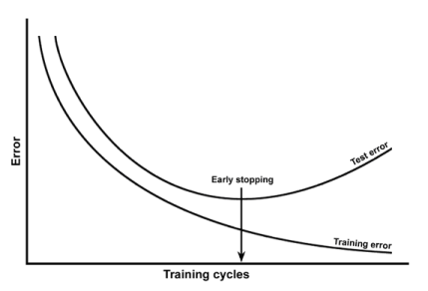
Early stopping
To tackle overfitting another popular technique is early stopping
Monitor performance on a separate validation set
Training the network will decrease training error, as well validation error (although with a slower rate usually)
Stop when validation error starts increasing
This quite likely means the network starts to overfit

Slide 34
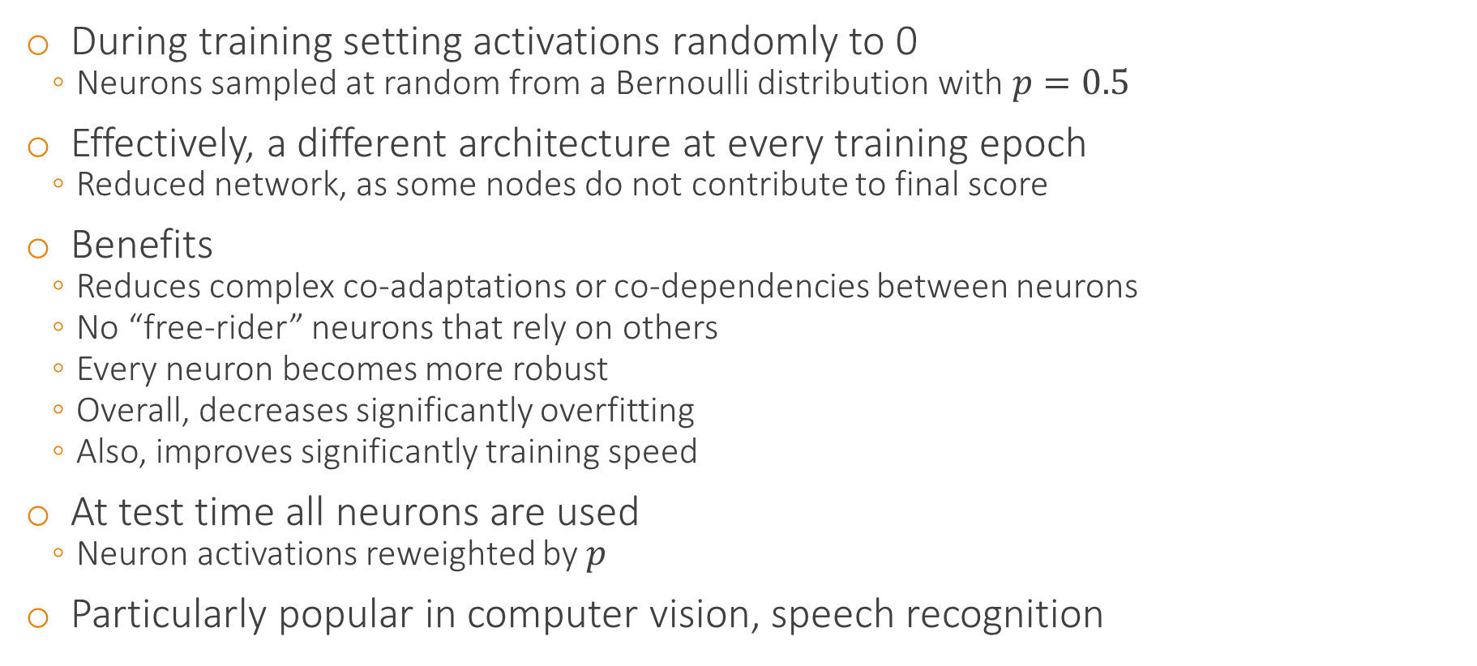
Dropout
During training setting activations randomly to 0
Neurons sampled at random from a Bernoulli distribution with $p=0.5$
Effectively, a different architecture at every training epoch
Reduced network, as some nodes do not contribute to final score
Benefits
Reduces complex co-adaptations or co-dependencies between neurons
No “free-rider” neurons that rely on others
Every neuron becomes more robust
Overall, decreases significantly overfitting
Also, improves significantly training speed
At test time all neurons are used
Neuron activations reweighted by $p$
Particularly popular in computer vision, speech recognition

Slide 35
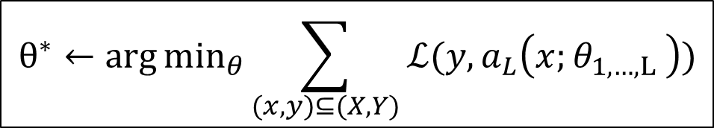
Architectural details
1. The Neural Network
$$a_{L}\left(x;θ_{1,…,L} \right)=h_{L} (h_{L−1}\left(…h_{1}\left(x,θ_{1}\right),θ_{L−1}\right), θ_{L})$$
2. Learning by minimizing empirical error
$$θ^{∗}←\arg{\min_{θ}{\sum_{(x,y)⊆(X, Y)}{ℒ(y,a_{L}\left(x;θ_{1,…,L} \right))}}}$$
3. Optimizing with Gradient Descend based methods
$$θ^{(t+1)}=θ^{(t)}−η_{t}∇_{θ}ℒ$$

Slide 36


Sigmoid-like activation functions
Straightforward sigmoids are not a very good idea
Symmetric sigmoids, like tanh, converge faster
A recommended sigmoid is $a=h\left(x\right)=1.7159\tanh{(\frac{2}{3}x)}$
A $tanh$ can be computationally expensive, maybe approximate by ratio of polynomials
You can add a linear term to avoid flat areas
$$a=h\left(x\right)=\tanh\left(x\right)+βx$$

Slide 37


RBFs vs “Sigmoids”
RBF: $a=h\left(x\right)=\sum_{j}{u_{j}\exp\left(−β_{j}{\left(x−w_{j}\right)}^{2}\right)}$
Sigmoid: $a=h\left(x\right)=σ\left(x\right)=\frac{1}{1+e^{−x}}$
Sigmoids can cover the full feature space
RBF’s are much more local in the feature space
Can be faster to train but with a more limited range
Can give better set of basis functions
Preferred in lower dimensional spaces

Slide 38


Rectified Linear Unit (ReLU) module (Alexnet)
Activation function $a=h(x)=\max\left(0, x\right)$
Gradient wrt the input $\frac{∂a}{∂x}=\left\{\begin{aligned}0, if x≤0 \\ 1, ifx>0\end{aligned}\right.$
Very popular in computer vision and speech recognition
Much faster computations, gradients
No vanishing or exploding problems, only comparison, addition, multiplication
People claim biological plausibility
Sparse activations
No saturation
Non-symmetric
Non-differentiable at 0
A large gradient during training can cause a neuron to “die”. Higher learning rates mitigate the problem

Slide 39

ReLU convergence rate
ReLU
Tanh

Slide 40

Other ReLUs
Soft approximation (softplus): $a=h(x)=\ln\left(1+ e^{x}\right)$
Gradient is the sigmoid $\frac{∂a}{∂x}=σ(χ)$
Noisy ReLU: $a=h\left(x\right)=max \left(0, x+ε\right), ε\sim Ν(0, σ(x))$
Leaky ReLU: $a=h\left(x\right)=\left\{\begin{aligned}x, if x>0 \\ 0.01x otherwise\end{aligned}\right.$
Parametric ReLu: $a=h\left(x\right)=\left\{\begin{aligned}x, if x>0 \\ βx otherwise\end{aligned}\right.$
parameter $β$ is trainable

Slide 41
Architectural hyper-parameters
Number of hidden layers
Number of neuron in each hidden layer
Type of activation functions
Type and amount of regularization

Slide 42
Number of hidden units, number of hidden layers
Getting these hyper-parameters is dataset dependent
Start small and gradually increase complexity
With no regularization the plot of number of hidden units vs. generalization performance graph will be U-shaped
E.g. start with a few hidden layers, 2 or 3
And a few dozen hidden units per layer and see if performance is reasonable
Start increasing the number of layers and see if performance improves
Start increasing the number of hidden units and see if performance improves

Slide 43

Use $ℓ_{2}$-regularization!
In general though $ℓ_{2}$-regularization is more important!!
It’s alright if you have a deep or wide network
If there is the $ℓ_{2}$-regularization is strong enough, your network will generally not overfit

Slide 44

Learning rate
1. The Neural Network
$$a_{L}\left(x;θ_{1,…,L} \right)=h_{L} (h_{L−1}\left(…h_{1}\left(x,θ_{1}\right),θ_{L−1}\right), θ_{L})$$
2. Learning by minimizing empirical error
$$θ^{∗}←\arg{\min_{θ}{\sum_{(x,y)⊆(X, Y)}{ℒ(y,a_{L}\left(x;θ_{1,…,L} \right))}}}$$
3. Optimizing with Gradient Descend based methods
$$θ^{(t+1)}=θ^{(t)}−η_{t}∇_{θ}ℒ$$

Slide 45
Learning rate
The right learning rate is important for fast convergence
Too strong, the gradients overshoot and bounce
Too weak, the gradients are too small to influence the parameters → slow training
Sometimes learning rate per weight is advantageous
Some weights are near convergence, others not
If weights are shared, a good idea is the learning rate to be proportional to the square root of the number of connections sharing the weight
Adaptive learning rates are also possible, based on the errors observed
[Sompolinsky1995]

Slide 46

Learning rate schedules
Constant
Learning rate remains the same for all epochs
Step decay
Decrease (e.g. $η_{t}/2$ or $η_{t}/10$) every T number of epochs
Inverse decay $η_{t}=\frac{η_{0}}{1+εt}$
Exponential decay $η_{t}=η_{0}e^{−εt}$
Generally step decay is simple, intuitive, it works well and does not require tuning extra hyper-parameters, other than when to decrease $η_{t}$

Slide 47

Learning rate in practice
Try several log-spaced values ${10}^{−1},{10}^{−2},{10}^{−3}, …$ on a smaller set
Then, you can narrow it down from there around where you get the lowest error
You can decrease the learning rate every 10 (or some other value) full training set epochs
Although this highly depends on your data

Slide 48

Weight initialization
1. The Neural Network
$$a_{L}\left(x;θ_{1,…,L} \right)=h_{L} (h_{L−1}\left(…h_{1}\left(x,θ_{1}\right),θ_{L−1}\right), θ_{L})$$
2. Learning by minimizing empirical error
$$θ^{∗}←\arg{\min_{θ}{\sum_{(x,y)⊆(X, Y)}{ℓ(y,a_{L}\left(x;θ_{1,…,L} \right))}}}$$
3. Optimizing with Gradient Descend based methods
$$θ^{(t+1)}=θ^{(t)}−η_{t}∇_{θ}ℒ$$

Slide 49

Weight initialization
There are few contradictory requirements
Weights need to be small enough
e.g. around the origin ($\vec{0}$) for symmetric functions (tanh, sigmoid)
the activation functions operate near their linear regime → large gradients → faster training
Weights need to be large enough
The generated gradients are also large enough → faster training

Slide 50

Weight initialization
Weights must be initialized to preserve the variance of the activations during the forward and backward computations, especially for deep learning
All neurons operate in their full capacity
Good practice: initialize weights to be asymmetric, e.g. no same values for different weights (like all $\vec{0}$)
Otherwise all neurons generate the same gradient, no real change
Alternatively, initialize to $\vec{0}$ but break some node to node connections to create asymmetries
Generally, Initialization must be coordinated with the choice of non-linear activation functions and data normalization

Slide 51


Weight initialization for sigmoid-like neurons
For tanh initialize weights from $\left[−\sqrt{\frac{6}{d_{l−1}+d_{l}}},\sqrt{\frac{6}{d_{l−1}+d_{l}}}\right]$
$d_{l−1}$ is the number of input variables to the tanh layer and $d_{l}$is the number of the output variables
For a sigmoid $\left[−4∙\sqrt{\frac{6}{d_{l−1}+d_{l}}},4∙\sqrt{\frac{6}{d_{l−1}+d_{l}}}\right]$
Large gradients
Linear regime

Slide 52

Weight initialization for ReLUs
For ReLU’s you also want to initialize the weights so the neurons have similar variances
Currently the suggested practice is to fill in the weights with random samples draw from
$$w\sim N\left(0, \sqrt{2/d}\right)$$
where $d$ is the number of neurons in the input [HeICCV2015]

Slide 53

Loss functions
1. The Neural Network
$$a_{L}\left(x;θ_{1,…,L} \right)=h_{L} (h_{L−1}\left(…h_{1}\left(x,θ_{1}\right),θ_{L−1}\right), θ_{L})$$
2. Learning by minimizing empirical error
$$θ^{∗}←\arg{\min_{θ}{\sum_{(x,y)⊆(X, Y)}{ℒ(y,a_{L}\left(x;θ_{1,…,L} \right))}}}$$
3. Optimizing with Gradient Descend based methods
$$θ^{(t+1)}=θ^{(t)}−η_{t}∇_{θ}ℒ$$

Slide 54





Multi-class classification
Our samples contains only one class
There is only one correct answer per sample
Negative log-likelihood (cross entropy) + Softmax
$ℒ\left(θ;x, y\right)=−\sum_{c=1}^{C}{y_{c}\log{a_{L}^{c}}}$ for all classes $c=1, …, C$
Hierarchical softmax when C is very large
Hinge loss (aka SVM loss)
$$ℒ\left(θ;x, y\right)=\sum_{\begin{aligned}c=1 \\ c≠y\end{aligned}}^{C}{\max{(0,a_{L}^{c}−a_{L}^{y}+1)}}$$
Squared hinge loss
Is it a cat? Is it a horse? …

Slide 55


Multi-class, multi-label classification
Each sample can have many correct answers
Hinge loss and the likes
Also sigmoids would also work
Each output neuron is independent
“Does this contain a car, yes or no?“
“Does this contain a person, yes or no?“
“Does this contain a motorbike, yes or no?“
“Does this contain a horse, yes or no?“
Instead of “Is this a car, motorbike or person?”
$p\left(car\right|x)=0.55, p\left(m/bike\right|x)=0.25,p\left(person\right|x)=0.15,p\left(horse\right|x)=0.05$
$p\left(car\right|x)+p\left(m/bike\right|x)+p\left(person\right|x)+p\left(horse\right|x)=1.0$

Slide 56

Regression
The good old sum of squared errors
$$ℒ\left(θ;x, y\right)=\frac{1}{2}{|{y−a}_{L}|}_{2}^{2}$$
Or the $ℓ_{1}$ distance
$$ℒ\left(θ;x, y\right)=\sum_{j}{|y_{j}−a_{L}^{j}|}$$

Slide 57

Even better optimizations
1. The Neural Network
$$a_{L}\left(x;θ_{1,…,L} \right)=h_{L} (h_{L−1}\left(…h_{1}\left(x,θ_{1}\right),θ_{L−1}\right), θ_{L})$$
2. Learning by minimizing empirical error
$$θ^{∗}←\arg{\min_{θ}{\sum_{(x,y)⊆(X, Y)}{ℒ(y,a_{L}\left(x;θ_{1,…,L} \right))}}}$$
3. Optimizing with Gradient Descend based methods
$$θ^{(t+1)}=θ^{(t)}−η_{t}∇_{θ}ℒ$$

Slide 58


Momentum
Loss surface
Instead of switching gradients all the time, maintain some “momentum” from the previous parameters
Gradients and learning are more robust, faster convergence
Nice “physics”-based interpretation
Instead of updating the position of the “ball”, we update the velocity, which will update the position
Gradient + momentum
Gradient
$$u_{θ}={γθ}^{(t)}−η_{t}∇_{θ}ℒ$$
$$θ^{(t+1)}=θ^{(t)}+u_{θ}$$

Slide 59


Nesterov Momentum
Gradient + momentum
Use the future gradient instead of the current gradient
Better theoretical convergence
Generally works better with Convolutional Neural Networks
Momentum
$$u_{θ}={γθ}^{(t)}−η_{t}∇_{θ}ℒ$$
$$θ^{(t+1)}=θ^{(t)}+u_{θ}$$
Gradient
Gradient + Nesterov momentum
Momentum
Look-ahead gradient from the next step

Slide 60

Second order optimizations
Normally we update all weights with same “aggressiveness”
Yet, some parameters could enjoy more “teaching”
While others are already about there
Second-order methods adapt the learning according to the per parameter behavior
$$θ^{(t+1)}=θ^{(t)}−H_{ℒ}^{−1}η_{t}∇_{θ}ℒ$$
$H_{ℒ}$ is the Hessian matrix of $ℒ$ containing all second-order derivatives
$$H_{ℒ}^{ij}=\frac{∂ℒ}{∂θ_{i}∂θ_{j}}$$

Slide 61
Second order optimization methods in practice
Computing the inverse of the Hessian with thousands of parametesr is usually very expensive
Instead approximations are sough for, e.g. the L-BFGS algorithm
Keeps memory of gradients to approximate the inverse Hessian
However, L-BFGS works alright with Batch Gradient Descend
What about SGD?
In practice SGD with a good momentum works alright

Slide 62
Per parameter adaptive optimization
Adagrad [Duchi2011]
RMSprop
Adam [Kingma2014]

Slide 63

Adagrad [Duchi2011]
Schedule
$m_{j}=\sum_{τ}{{(∇_{θ}ℒ_{j})}^{2}} ⟹ θ^{(t+1)}=θ^{(t)}−η_{t}\frac{∇_{θ}ℒ}{\sqrt{m}+ε}$
$ε$ is a small number to avoid division with 0
Gradients become gradually smaller and smaller

Slide 64


RMSprop
Schedule
$m_{j}=α\sum_{τ=1}^{t−1}{{(∇_{θ}ℒ_{j})}^{2}}+\left(1−α\right)∇_{θ}^{(t)}ℒ_{j} ⟹{ θ}^{(t+1)}=θ^{(t)}−η_{t}\frac{∇_{θ}ℒ}{\sqrt{m}+ε}$
$α$ is a decay hyper-parameter
Similar like Adagrad, but uses a moving average of the squared gradients
When gradients are too large (maybe too “noisy” loss surface)
Updates are tamed
When gradients are too small (maybe stuck in flat loss surface ravine)
Updates become more aggressive
Square rooting boosts small values while suppresses large values

Slide 65

Adam [Kingma2014]
$m_{j}=\sum_{τ}{{(∇_{θ}ℒ_{j})}^{2}}$
$θ^{(t+0.5)}=β_{1}θ^{(t)}+\left(1−β_{1}\right)∇_{θ}ℒ$
$v^{(t+0.5)}=β_{2}v^{(t)}+\left(1−β_{2}\right)m$
$θ^{(t+1)}=θ^{(t)}−η_{t}\frac{θ^{(t+0.5)}}{\sqrt{v^{(t+0.5)}}+ε}$
Similar to RMSprop with momentum
Recommended values: $β_{1}=0.9$, $β_{2}=0.999, ε={10}^{−8}$

Slide 66


Visual overview
Picture credit: Alec Radford

Slide 67

Good practice
Preprocess the data to have 0 mean
Either normalize to have standard deviation 1 or the inputs to lie in the range [-1, 1]
Initialize weights according to you activations functions
For ReLU initialize from $N(0, \sqrt{\frac{2}{d}})$, d is the number of input neurons
Always use $ℓ_{2}$-regularization and dropout
Use batch normalization

Slide 68

Babysitting Deep Nets
1. The Neural Network
$$a_{L}\left(x;θ_{1,…,L} \right)=h_{L} (h_{L−1}\left(…h_{1}\left(x,θ_{1}\right),θ_{L−1}\right), θ_{L})$$
2. Learning by minimizing empirical error
$$θ^{∗}←\arg{\min_{θ}{\sum_{(x,y)⊆(X, Y)}{ℒ(y,a_{L}\left(x;θ_{1,…,L} \right))}}}$$
3. Optimizing with Gradient Descend based methods
$$θ^{(t+1)}=θ^{(t)}−η_{t}∇_{θ}ℒ$$

Slide 69
Babysitting Deep Nets
Check your gradients
Check that in the first round you get a random loss
Check network with few samples
Turn off regularization. You should predictably overfit and have a 0 loss
Turn or regularization. The loss should increase
Have a separate validation set
Compare the curve between training and validation sets
There should be a gap, but not too large

Slide 70
Summary
How to defining our model and optimize it in practice
Data preprocessing and normalization
Optimization methods
Regularizations
Architectures and architectural hyper-parameters
Learning rate
Weight initializations
Good practices

Slide 71
Next lecture
What are the Convolutional Neural Networks?
Why are they so important for Computer Vision?
How do they differ from standard Neural Networks?
How can we train a Convolutional Neural Network?

